Slide 1
Search Illustration and example

Slide 2
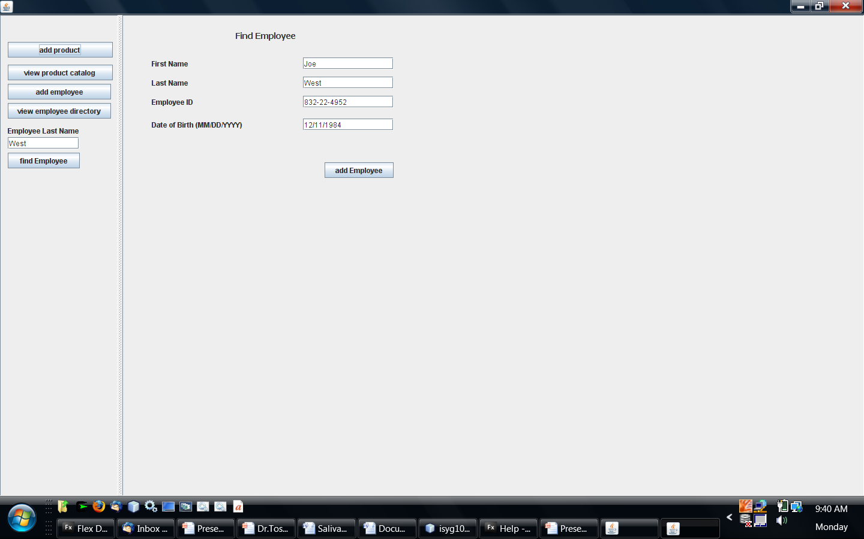

Slide 3
Use enters last name
User hits find button
MainJFrame captures push button event
MainJframew extracts text from employeelasname textfield
MainJFrame uses the employeedirectory to find the employee object that matches the entered last name
The findEmpoyee Jpanel takes an employee object as input. In the constructor we map the attributes of the employee object to the text fields of the jpanel. We use setText() method on the text fields
Employee.getFirstName()
Employee.getLasName()
:
1
2
LastnameTextfield.getText()
4
3
6
This section of code is the actionperformed event in the MainJFrame
Display employee data into
findEmployeejpanel screen
:
5
employeedirectory.findByLastName( )
Returned employee object
Found employee object

Slide 4
Example 1:findEmployeeByLastName Method
Add the following method and attribute to the EmployeeDirectory class
ArrayList employeelist; //define a new reference variable to hold the list of employees
Public Employee findEmployeeByLastName( String ln ){
Employeelist = employeedirectory.getEmployeeList(); // retrieve the list of employees from the direcoty
//now go through the list, one employee at the time to find the object that has a last name that matches the input ln
//if there is a match on the last name attribute then return the employee object with that attribute (last name in this //case
For (Employee currentemployee : employeelist){
If (currentemployee .getLastName().equals(ln) ) return currentemployee ;
} // keep going back while there is no match
Return null; // the program gets to this line if no mtach was found which means return null;

Slide 5
Example 2: findEmployeeByLastNameOrZipCode Method
This example assumes there is an addresss object attached to the employee (not shown in the form)
Public Employee findEmployeeByLastNameOrZipCode ( String ln ){
Employeelist = employeedirectory.getEmployeeList(); // retrieve the list of employees from the directory
//now go through the list, one employee at the time to find the employee or the address object that has a last name that matches the input parameter or the zipcode attribute from the associated address:
//if there is a match on the on either attribute then return the employee object with that attribute (last name or zipcode in this case
String zipcode, lastname; //define 2 temp attributes to hold current employee info
For (Employee currentemployee : employeelist){
lastname = currentemployee.getLastName();
zipcode = currentemployee.getAddress().getZipCode();
If (lastname.equals(ln) || zipcode.equals(ln)
) return currentemployee ;
} // keep going back while there is no match
Return null; // the program gets to this line if no mtach was found which means return null;

